Slide 1
Progressive Lightcuts for GPU
Tomáš Davidovič
I. Georgiev, P. Slusallek
Saarland University, Intel VCI
Notes:
Good morning everyone. I really hope you all went to the manylight course yesterday.

Slide 2
Direct illumination
Notes:
In case you didn’t, lets go over the basics really quick. We have our cornell box with a single light at the top.

Slide 3
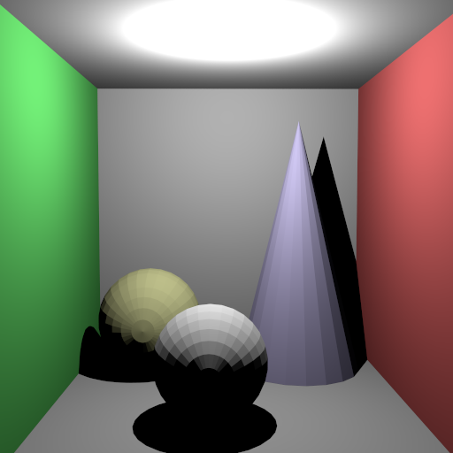
Direct illumination
Notes:
Illuminating just from that, we get direct illumination with all the hard shadows. It is important, but we also want color bleeding and overall, the indirect illumination.

Slide 4
VPL Rendering
Notes:
One of the many many possible methods to do that is based on Virtual Point Lights, or VPLs.
There we shoot particles from the primary light, and where there land we create a new point light.

Slide 5
VPL Rendering
Notes:
And we repeat the process for multiple bounces

Slide 6
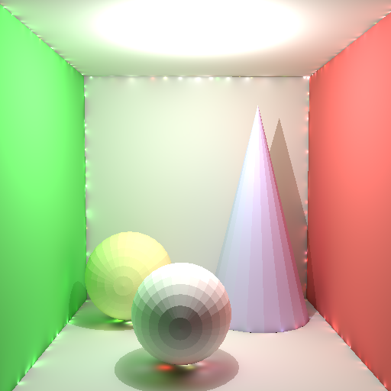
VPL Rendering
Bruteforce: 11s
Notes:
And in the end get something like this. Here I used about 10 thousand VPLs, so you can see quite a lot of artifacts along corners, but you can also see that the shadows are not perfectly black anymore and even hints of colorbleeding. Unfortunately, the whole thing took 11 seconds to properly render, and that is not really viable. So lets see if we can do better, and I am now going to change to result of Lightcuts.
Say I am going to change!

Slide 7
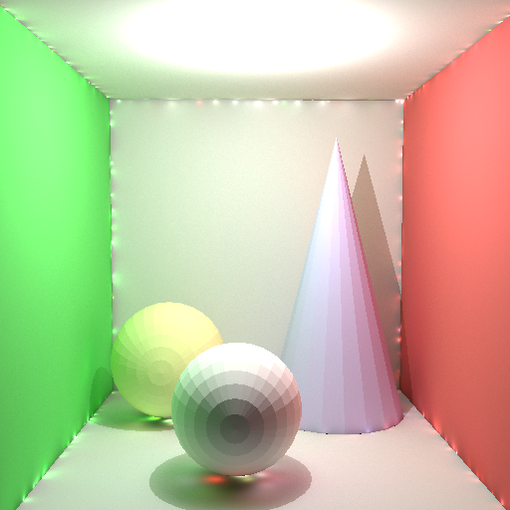
VPL Rendering
Lightcuts: 2s
Notes:
And hopefully, the only difference you noticed is the reduced rendering time. It went down about 5x, when the number of VPL is larger and the scene more complex, the difference is much more drastic.

Slide 8
VPL Rendering
Notes:
So what’s the difference. In bruteforce rendering, we connect our yellow shading point to every single VPL. That means shooting 10k rays per pixel.

Slide 9
VPL Rendering
Notes:
In lightcuts, we do the same thing for some lights

Slide 10
VPL Rendering

Slide 11
Lightcuts

Slide 12
Lightcuts

Slide 13
Lightcuts

Slide 14
Lightcuts

Slide 15
Lightcuts – progressive #1
Notes:
Introduce why progressive

Slide 16
Lightcuts – progressive #1

Slide 17
Lightcuts – progressive #2
Lightcuts, 20s
Reference

Slide 18
Lightcuts – progressive #2
Lightcuts, 20s
Bruteforce, 2400s

Slide 19
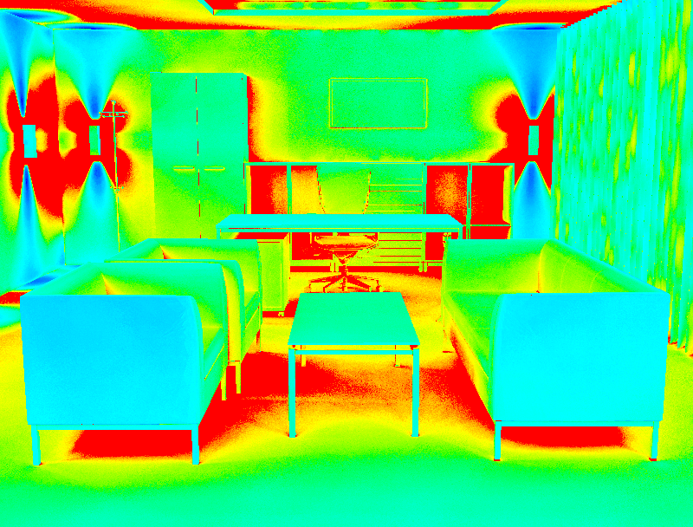
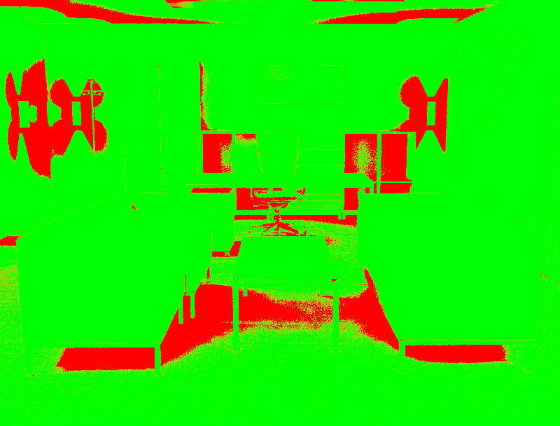
Lightcuts – Heapless
Lightcuts, 10s
Cut size
Heapless

Slide 20
Lightcuts – clamping
Unclamped

Slide 21
Lightcuts – clamping
Clamped

Slide 22
Clamping
Notes:
Say we will derive better clamping than constant.

Slide 23
Clamping
Contrib. ≈ k / (d^2)

Slide 24
Clamping
Contrib. ≈ k / (d^2)

Slide 25
Clamping
m
Contrib. ≈ k / (max(d, m)^2)
m

Slide 26
Clamping
b
Contrib. ≈ min( k / d^2, b )
b

Slide 27
Clamping – some math
Contribution ≈ k / d^2
P( ray.length ) ≈ ray.length^2
Mathematica happens
Variance ≈ sqrt( b )
Bias ≈ 1 / sqrt( b )
MSE = Variance + Bias^2 = sqrt( b ) + 1 / b
Optimal convergence:
b = base * iteration ^ 0.66
Notes:
Say iterations ~ #VPLs

Slide 28
Results – Manual clamping
Notes:
Say ~ This is not the lowest error, that is actually (nextslide)

Slide 29
Results – lowest RMSE

Slide 30
Results - RMSE

Slide 31
Results - RMSE

Slide 32
Results - RMSE

Slide 33
Results - RMSE

Slide 34
Conclusion
GPU Lightcuts work
Limited by memory
Progressive – averaging images
Needs clamping
Can relax clamping – #VPLs ^ 0.66
Works for any VPL method
Look into Multidimensional Lightcuts

Slide 35
Tomáš Davidovič
Notes:
And thank you for your attention

