Slide 1
RTfact: Concepts for Generic and High Performance Ray Tracing
Iliyan Georgiev
University of Saarland
Philipp Slusallek
University of Saarland
DFKI Saarbrücken

Slide 2
Ray tracers are used in RT08 papers
Change packet size?
Change data structures?
No common software base
No tools for writing composable software
Cannot reuse and combine parts
Comparison/benchmarking difficult
RT08 – arguments for combining more different structures and algorithms

Slide 3
Trends
Hardware trends
Massive compute power
Massive memory bandwidth
Massive parallelism
Multi-core chips
Data-parallel computation
Different architectures
Composable portability
Not 1:1, but reuse as much as possible

Slide 4
Trends
More capable hardware
Trend towards software-based graphics
GPUs
Larrabee
Need fast and flexible software architectures

Slide 5
Existing Ray Tracing Systems
Performance gap between flexible and interactive systems
Extreme examples
PBRT [Pharr et al. 2004]
Fine-grained abstractions
Highly extensible
Slow
Arauna [Bikker 2007]
High performance
Fixed functionality
Hand-optimized
Ideally – both performance and flexibility

Slide 6
Possible Approaches
Manual SIMD coding
Automatic compiler techniques
Object-oriented programming
Domain-specific languages

Slide 7
Possible Approaches
On the Lower Level
Manual coding (e.g. SSE intrinsics)
Best possible performance
Full control of what gets executed
Sensitive to small changes
Unintuitive programming model
Modern day assembly language
Not portable

Slide 8
Possible Approaches
On the Lower Level
Rely on compilers
The ideal solution
Do not have enough context
Application-specific optimizations?
Automatic parallelization?
No signs for getting smart enough soon

Slide 9
Possible Approaches
Object-oriented programming
Run-time flexibility
Late binding - virtual functions
Good when types are unknown at compile time
But
Coupling of algorithms and data structures
Different existing algorithms for the same structure (and vice versa)
Large run-time overhead at a fine granularity
Special-case code
Disables optimizations
Used only at coarse level (e.g. Manta)
Notes:
Good for a final solution
Examples for different algs and data struct N structures, M builders, P traversers -> combinatorial explosion
Example for overhead at a high granularity
Confuses composability and polymorphism

Slide 10
Possible Approaches
On Multiple Levels
Domain-specific language (DSL)
Simple application-suitable syntax
Specialized compiler with enough context
Limited scope make optimizations easier
Data parallelism
But
Need to juggle two different abstractions
Lots of infrastructure work
Tends to converge to a general purpose programming language

Slide 11
Requirements
Composability
At design/compile-time
Compatibility
Use existing tools
Integration with other software
Multi-level abstractions
From basic arithmetic types to renderers
Portability
Performance
Allow efficient code generation

Slide 12
Generic Programming
C++ Templates
Compile-time…
Composability
Specialization
Optimizations
Inlining
Enables
Arbitrary-grained abstractions
Performance
Decoupling of algorithms and data structures

Slide 13
Generic Programming
Generic algorithm
.Concepts
template<class Comparable>
void order(Comparable& element1, Comparable& element2) {
if(element1 > element2) {
Type tempElement = element2;
element2 = element1;
element1 = tempElement;
}
}
class Comparable
{
public:
bool operator>(const Comparable& other);
}

Slide 14
RTfact
General Infrastructure
Application or API
Rendering
Building
Ray tracing
Scene
management
SIMD primitives

Slide 15
Generic SIMD Primitives
Parallelism
Threading – on the algorithmic/application level
SIMD - impacts the whole infrastructure
4 basic SIMD primitives
Parameterized by size (at compile time)
Packet, Vec3f, PacketMask, BitMask
Simultaneously model 3 basic concepts
Value, ValueContainer, ContainerContainer
Packets have 3-fold nature
Portable
Different sizes means different types
Data is allocated on the stack

Slide 16
template<unsigned int size>
Vec3f<size> computeColor(Vec3f<size>& dir, Vec3f<size>& offset, Vec3f<size>& normal)
{
Packet<size,float> dotN;
PacketMask<size> mask;
BitMask<size> bitMask;
...
return color;
}

Slide 17
template<unsigned int size>
Vec3f<size> computeColor(Vec3f<size>& dir, Vec3f<size>& offset, Vec3f<size>& normal)
{
Packet<size,float> dotN;
PacketMask<size> mask;
BitMask<size> bitMask;
...
return color;
}
dotN = Dot(dir + offset, normal); //
mask = (dotNormal > Packet<size,float>::C_0()); // SCALAR-LIKE
color = mask.blend(Vec3f<size>::RED(), Vec3f<size>::BLACK()); // (Value concept)
bitMask = mask.getBitMask(); //

Slide 18
template<unsigned int size>
Vec3f<size> computeColor(Vec3f<size>& dir, Vec3f<size>& offset, Vec3f<size>& normal)
{
Packet<size,float> dotN;
PacketMask<size> mask;
BitMask<size> bitMask;
...
return color;
}
dotN = Dot(dir + offset, normal); //
mask = (dotNormal > Packet<size,float>::C_0()); // SCALAR-LIKE
color = mask.blend(Vec3f<size>::RED(), Vec3f<size>::BLACK()); // (Value concept)
bitMask = mask.getBitMask(); //
for(int i = 0; i < size; ++i) //
{ //
dotN [i] = Dot(dir[i] + offset[i], normal[i]); // COMPONENT-WISE
mask[i] = (dotl[i] > 0); // (ValueContainer
color.set(i, mask[i] ? Vec3f<1>::RED(), Vec3f<1>::BLACK()); // concept)
bitMask.set(i, mask[i]); //
} //

Slide 19
template<unsigned int size>
Vec3f<size> computeColor(Vec3f<size>& dir, Vec3f<size>& offset, Vec3f<size>& normal)
{
Packet<size,float> dotN;
PacketMask<size> mask;
BitMask<size> bitMask;
...
return color;
}
dotN = Dot(dir + offset, normal); //
mask = (dotNormal > Packet<size,float>::C_0()); // SCALAR-LIKE
color = mask.blend(Vec3f<size>::RED(), Vec3f<size>::BLACK()); // (Value concept)
bitMask = mask.getBitMask(); //
for(int i = 0; i < size; ++i) //
{ //
dotN [i] = Dot(dir[i] + offset[i], normal[i]); // COMPONENT-WISE
mask[i] = (dotl[i] > 0); // (ValueContainer
color.set(i, mask[i] ? Vec3f<1>::RED(), Vec3f<1>::BLACK()); // concept)
bitMask.set(i, mask[i]); //
} //
for(int i = 0; i < Packet<size, float>::CONTAINER_COUNT; ++i) //
{ //
dotN (i) = Dot(dir(i) + offset(i), normal(i)); //
mask(i) = (dotN(i) > Packet<size,float>::Container::C_0()); // CONTAINER-WISE
color(i) = mask(i).blend(Vec3f<size>::Container::RED(), // (ContainerContainer
Vec3f<size>::Container::BLACK()); // concept)
bitMask.setContainer(i, mask(i).getBitMask()); //
}

Slide 20
Rays and Ray Packets
Ray packets – aggregation of other packets
Single rays simply have size 1
Different packets are different types
Can exist at the same time
template<unsigned int size>
struct RayPacket
{
Vec3f<size> org;
Vec3f<size> dir;
Packet<size, float> tMin;
Packet<size, float> tMax;
}
RayPacket<1> ray;

Slide 21
Algorithms and Data Structures
Data structures decoupled from algorithms
Algorithms are described in terms of concepts
template<class Element>
class KdTree : public Primitive {
public:
class NodeIterator;
class ElementIterator;
// interface for structure building
void createInnerNode(NodeIterator node, int axis, float splitVal);
template<class Iterator>
void createLeaf(NodeIterator leaf, const BBox& bounds,
Iterator begin, Iterator end);
// interface for structure traversal
NodeIterator getRoot() const;
NodeIterator getLeftChild(NodeIterator node) const;
NodeIterator getRightChild(NodeIterator node) const;
int getSplitAxis(NodeIterator node) const;
float getSplitValue(NodeIterator node) const;
std::pair<ElementIterator, ElementIterator>
getElements(NodeIterator leaf) const;
};
Notes:
Note that acceleration structures do not contain algorithms, we build them on top; can afford this because the compiler can optimize

Slide 22
template<class ElemIsect> // nested element intersector
template<int intersDataMask, // intersection data needed
bool commonOrg, // common ray origin?
unsigned int size, // size of the ray packet
class KdTree> // models the KdTree concept
void KdTreeIntersector<ElemIsect>::intersect(
RayPacket<size>& rayPacket, // the actual rays
KdTree& tree, // the actual kd-tree
ElemIsect::Intersection<size>& r) // intersection defined by the nested intersector
{
typedef BitMask<size> t_BitMask;
typedef Packet<size, float> t_Packet;
typedef typename t_Packet::Container t_PContainer;
...
while((splitDim = tree.getSplitAxis(node)) != 3) {
t_PContainer splitValue = t_PContainer::replicate(tree.getSplitValue(node));
t_BitMask nearChildMask, farChildMask;
t_PContainer tSplitFactor;
if(commonOrg) // compile-time constant decision
tSplitFactor = splitValue - rayPacket.org(0).get(splitDimension);
for(int i = 0; i < RayPacket<size>::CONTAINER_COUNT; ++i)
{
if(!commonOrg) // compile-time constant decision
tSplitFactor = splitValue - rayPacket.org(i).get(splitDimension);
const t_PContainer tSplit = tSplitFactor * rayPacket.invDir(i).get(splitDimension);
nearChildMask.setContainer(i, (tSplit(i) > currentTMax(i)).getIntMask());
farChildMask.setContainer(i, (currentTMin(i) > tSplit(i)).getIntMask());
}
/* omitted: determine the nearest child from masks and descend */
}
/* omitted: leaf intersection and stack operations */
}

Slide 23
template<class ElemIsect> // nested element intersector
template<int intersDataMask, // intersection data needed
bool commonOrg, // common ray origin?
unsigned int size, // size of the ray packet
class KdTree> // models the KdTree concept
void KdTreeIntersector<ElemIsect>::intersect(
RayPacket<size>& rayPacket, // the actual rays
KdTree& tree, // the actual kd-tree
ElemIsect::Intersection<size>& r) // intersection defined by the nested intersector
{
typedef BitMask<size> t_BitMask;
typedef Packet<size, float> t_Packet;
typedef typename t_Packet::Container t_PContainer;
...
while((splitDim = tree.getSplitAxis(node)) != 3) {
t_PContainer splitValue = t_PContainer::replicate(tree.getSplitValue(node));
t_BitMask nearChildMask, farChildMask;
t_PContainer tSplitFactor;
if(commonOrg) // compile-time constant decision
tSplitFactor = splitValue - rayPacket.org(0).get(splitDimension);
for(int i = 0; i < RayPacket<size>::CONTAINER_COUNT; ++i)
{
if(!commonOrg) // compile-time constant decision
tSplitFactor = splitValue - rayPacket.org(i).get(splitDimension);
const t_PContainer tSplit = tSplitFactor * rayPacket.invDir(i).get(splitDimension);
nearChildMask.setContainer(i, (tSplit(i) > currentTMax(i)).getIntMask());
farChildMask.setContainer(i, (currentTMin(i) > tSplit(i)).getIntMask());
}
/* omitted: determine the nearest child from masks and descend */
}
/* omitted: leaf intersection and stack operations */
}

Slide 24
template<class ElemIsect> // nested element intersector
template<int intersDataMask, // intersection data needed
bool commonOrg, // common ray origin?
unsigned int size, // size of the ray packet
class KdTree> // models the KdTree concept
void KdTreeIntersector<ElemIsect>::intersect(
RayPacket<size>& rayPacket, // the actual rays
KdTree& tree, // the actual kd-tree
ElemIsect::Intersection<size>& r) // intersection defined by the nested intersector
{
typedef BitMask<size> t_BitMask;
typedef Packet<size, float> t_Packet;
typedef typename t_Packet::Container t_PContainer;
...
while((splitDim = tree.getSplitAxis(node)) != 3) {
t_PContainer splitValue = t_PContainer::replicate(tree.getSplitValue(node));
t_BitMask nearChildMask, farChildMask;
t_PContainer tSplitFactor;
if(commonOrg) // compile-time constant decision
tSplitFactor = splitValue - rayPacket.org(0).get(splitDimension);
for(int i = 0; i < RayPacket<size>::CONTAINER_COUNT; ++i)
{
if(!commonOrg) // compile-time constant decision
tSplitFactor = splitValue - rayPacket.org(i).get(splitDimension);
const t_PContainer tSplit = tSplitFactor * rayPacket.invDir(i).get(splitDimension);
nearChildMask.setContainer(i, (tSplit(i) > currentTMax(i)).getIntMask());
farChildMask.setContainer(i, (currentTMin(i) > tSplit(i)).getIntMask());
}
/* omitted: determine the nearest child from masks and descend */
}
/* omitted: leaf intersection and stack operations */
}

Slide 25
template<class ElemIsect> // nested element intersector
template<int intersDataMask, // intersection data needed
bool commonOrg, // common ray origin?
unsigned int size, // size of the ray packet
class KdTree> // models the KdTree concept
void KdTreeIntersector<ElemIsect>::intersect(
RayPacket<size>& rayPacket, // the actual rays
KdTree& tree, // the actual kd-tree
ElemIsect::Intersection<size>& r) // intersection defined by the nested intersector
{
typedef BitMask<size> t_BitMask;
typedef Packet<size, float> t_Packet;
typedef typename t_Packet::Container t_PContainer;
...
while((splitDim = tree.getSplitAxis(node)) != 3) {
t_PContainer splitValue = t_PContainer::replicate(tree.getSplitValue(node));
t_BitMask nearChildMask, farChildMask;
t_PContainer tSplitFactor;
if(commonOrg) // compile-time constant decision
tSplitFactor = splitValue - rayPacket.org(0).get(splitDimension);
for(int i = 0; i < RayPacket<size>::CONTAINER_COUNT; ++i)
{
if(!commonOrg) // compile-time constant decision
tSplitFactor = splitValue - rayPacket.org(i).get(splitDimension);
const t_PContainer tSplit = tSplitFactor * rayPacket.invDir(i).get(splitDimension);
nearChildMask.setContainer(i, (tSplit(i) > currentTMax(i)).getIntMask());
farChildMask.setContainer(i, (currentTMin(i) > tSplit(i)).getIntMask());
}
/* omitted: determine the nearest child from masks and descend */
}
/* omitted: leaf intersection and stack operations */
}

Slide 26
Algorithms and Data Structures
Compositions
Acceleration structures can store objects of any type
Unified intersector interfaces
// data structure
BVH<KdTree<Triangle>> tree;
// corresponding intersector
BVHIntersector<KdTreeIntersector<
SimpleTriangleIntersector>> intersector;

Slide 27
Rendering Components
Shading
No shading in basic ray tracing components
Integrator – the shading “entry point”
Uses ray tracing components for visibility queries
Two shading models supported
Classic “imperative” (OpenRT- and Manta-like)
Convenient and powerful
Ray coherence problems
Decoupled “declarative” (PBRT-like)
Can preserve ray coherence
Limited to physically-based shading

Slide 28
struct Integrator {
template<unsigned int size> struct Result; // the result type
template<unsigned int size, class Sample, class Scene,
class Primitive, class Intersector>
Color<size> eval(Sample<size>& sample, // image sample
RayPacket<size>& rayPacket, // initial ray packet
Primitive& primitive, // top-level primitive
Intersector& intersector, // top-level intersector
Scene& scene); // shading scene data
};
struct Material {
template<unsigned int size, // packet size
unsigned int bsdfType> // BSDF parts to evaluate
void evaluate(Vec3f<size>& w_o, // outgoing direction
Vec3f<size>& w_i, // incoming direction
ShadingData<size>& sh, // hit point, normal, etc.
Vec3f<size>& result); // returns computed radiance
...
};
template<class Context> // for materials, lights, and rays
struct SurfaceShader {
template<bool commonOrg, // common ray origin?
unsigned int size> // packet size
void shade(const RayPacket<size>& rayPacket, // the actual rays
ShadingData<size>& intersection, // ray intersection structure
Context& context, // rendering context
Vec3f<size>& result); // returns computed radiance
};

Slide 29
struct Integrator {
template<unsigned int size> struct Result; // the result type
template<unsigned int size, class Sample, class Scene,
class Primitive, class Intersector>
Color<size> eval(Sample<size>& sample, // image sample
RayPacket<size>& rayPacket, // initial ray packet
Primitive& primitive, // top-level primitive
Intersector& intersector, // top-level intersector
Scene& scene); // shading scene data
};
struct Material {
template<unsigned int size, // packet size
unsigned int bsdfType> // BSDF parts to evaluate
void evaluate(Vec3f<size>& w_o, // outgoing direction
Vec3f<size>& w_i, // incoming direction
ShadingData<size>& sh, // hit point, normal, etc.
Vec3f<size>& result); // returns computed radiance
...
};
template<class Context> // for materials, lights, and rays
struct SurfaceShader {
template<bool commonOrg, // common ray origin?
unsigned int size> // packet size
void shade(const RayPacket<size>& rayPacket, // the actual rays
ShadingData<size>& intersection, // ray intersection structure
Context& context, // rendering context
Vec3f<size>& result); // returns computed radiance
};

Slide 30
struct Integrator {
template<unsigned int size> struct Result; // the result type
template<unsigned int size, class Sample, class Scene,
class Primitive, class Intersector>
Color<size> eval(Sample<size>& sample, // image sample
RayPacket<size>& rayPacket, // initial ray packet
Primitive& primitive, // top-level primitive
Intersector& intersector, // top-level intersector
Scene& scene); // shading scene data
};
struct Material {
template<unsigned int size, // packet size
unsigned int bsdfType> // BSDF parts to evaluate
void evaluate(Vec3f<size>& w_o, // outgoing direction
Vec3f<size>& w_i, // incoming direction
ShadingData<size>& sh, // hit point, normal, etc.
Vec3f<size>& result); // returns computed radiance
...
};
template<class Context> // for materials, lights, and rays
struct SurfaceShader {
template<bool commonOrg, // common ray origin?
unsigned int size> // packet size
void shade(const RayPacket<size>& rayPacket, // the actual rays
ShadingData<size>& intersection, // ray intersection structure
Context& context, // rendering context
Vec3f<size>& result); // returns computed radiance
};

Slide 31
Rendering Pipelines
Renderer – a top-level concept for processing image tiles

Slide 32
template<class PixelSampler, class Integrator>
class RayTracingRenderer : public Renderer {
PixelSampler m_sampler;
Integrator m_integrator;
public:
template<unsigned int size, // the size of primary ray packets
class Camera, class Scene, class Primitive,
class Intersector, class Framebuffer>
void render(
Scene& scene, Camera& camera,
Framebuffer& framebuffer, ImageClipRegion& clip,
Primitive& primitive, Intersector& intersector)
{
PixelSampler::Sample<size> sample;
PixelSampler::Iterator<size> it =
m_sampler.getIterator<size>(clip);
while(it.getNextSample(sample))
{
RayPacket<size> rays = camera.genRay(sample);
Integrator::Color<size> color = m_integrator.eval(
sample, rays, primitive, intersector, scene);
m_sampler.writeColor(sample, color, framebuffer);
}
}
/* omitted: preprocess() function for pre-integration*/
};

Slide 33
template<class PixelSampler, class Integrator>
class RayTracingRenderer : public Renderer {
PixelSampler m_sampler;
Integrator m_integrator;
public:
template<unsigned int size, // the size of primary ray packets
class Camera, class Scene, class Primitive,
class Intersector, class Framebuffer>
void render(
Scene& scene, Camera& camera,
Framebuffer& framebuffer, ImageClipRegion& clip,
Primitive& primitive, Intersector& intersector)
{
PixelSampler::Sample<size> sample;
PixelSampler::Iterator<size> it =
m_sampler.getIterator<size>(clip);
while(it.getNextSample(sample))
{
RayPacket<size> rays = camera.genRay(sample);
Integrator::Color<size> color = m_integrator.eval(
sample, rays, primitive, intersector, scene);
m_sampler.writeColor(sample, color, framebuffer);
}
}
/* omitted: preprocess() function for pre-integration*/
};

Slide 34
template<class PixelSampler, class Integrator>
class RayTracingRenderer : public Renderer {
PixelSampler m_sampler;
Integrator m_integrator;
public:
template<unsigned int size, // the size of primary ray packets
class Camera, class Scene, class Primitive,
class Intersector, class Framebuffer>
void render(
Scene& scene, Camera& camera,
Framebuffer& framebuffer, ImageClipRegion& clip,
Primitive& primitive, Intersector& intersector)
{
PixelSampler::Sample<size> sample;
PixelSampler::Iterator<size> it =
m_sampler.getIterator<size>(clip);
while(it.getNextSample(sample))
{
RayPacket<size> rays = camera.genRay(sample);
Integrator::Color<size> color = m_integrator.eval(
sample, rays, primitive, intersector, scene);
m_sampler.writeColor(sample, color, framebuffer);
}
}
/* omitted: preprocess() function for pre-integration*/
};

Slide 35
template<class PixelSampler, class Integrator>
class RayTracingRenderer : public Renderer {
PixelSampler m_sampler;
Integrator m_integrator;
public:
template<unsigned int size, // the size of primary ray packets
class Camera, class Scene, class Primitive,
class Intersector, class Framebuffer>
void render(
Scene& scene, Camera& camera,
Framebuffer& framebuffer, ImageClipRegion& clip,
Primitive& primitive, Intersector& intersector)
{
PixelSampler::Sample<size> sample;
PixelSampler::Iterator<size> it =
m_sampler.getIterator<size>(clip);
while(it.getNextSample(sample))
{
RayPacket<size> rays = camera.genRay(sample);
Integrator::Color<size> color = m_integrator.eval(
sample, rays, primitive, intersector, scene);
m_sampler.writeColor(sample, color, framebuffer);
}
}
/* omitted: preprocess() function for pre-integration*/
};

Slide 36
template<class PixelSampler, class Integrator>
class RayTracingRenderer : public Renderer {
PixelSampler m_sampler;
Integrator m_integrator;
public:
template<unsigned int size, // the size of primary ray packets
class Camera, class Scene, class Primitive,
class Intersector, class Framebuffer>
void render(
Scene& scene, Camera& camera,
Framebuffer& framebuffer, ImageClipRegion& clip,
Primitive& primitive, Intersector& intersector)
{
PixelSampler::Sample<size> sample;
PixelSampler::Iterator<size> it =
m_sampler.getIterator<size>(clip);
while(it.getNextSample(sample))
{
RayPacket<size> rays = camera.genRay(sample);
Integrator::Color<size> color = m_integrator.eval(
sample, rays, primitive, intersector, scene);
m_sampler.writeColor(sample, color, framebuffer);
}
}
/* omitted: preprocess() function for pre-integration*/
};

Slide 37
template<class PixelSampler, class Integrator>
class RayTracingRenderer : public Renderer {
PixelSampler m_sampler;
Integrator m_integrator;
public:
template<unsigned int size, // the size of primary ray packets
class Camera, class Scene, class Primitive,
class Intersector, class Framebuffer>
void render(
Scene& scene, Camera& camera,
Framebuffer& framebuffer, ImageClipRegion& clip,
Primitive& primitive, Intersector& intersector)
{
PixelSampler::Sample<size> sample;
PixelSampler::Iterator<size> it =
m_sampler.getIterator<size>(clip);
while(it.getNextSample(sample))
{
RayPacket<size> rays = camera.genRay(sample);
Integrator::Color<size> color = m_integrator.eval(
sample, rays, primitive, intersector, scene);
m_sampler.writeColor(sample, color, framebuffer);
}
}
/* omitted: preprocess() function for pre-integration*/
};

Slide 38
Putting It All Together
Example application
PinholeCamera camera;
OpenGLFrameBuffer fb;
BasicScene<Triangle> scene; //initialization omitted
BVH<Triangle> tree;
BVHBuilder builder;
BVHIntersector<PlueckerTriangleIntersector> intersector;
RayTracingRenderer<PixelCenterSampler,
DirectIlluminationIntegrator> renderer;
builder.build(tree, scene.prim.begin(), scene.prim.end());
renderer.render<64>(scene, camera, fb, fb.getClipRegion(),
tree, intersector);

Slide 39
Putting It All Together
Example application
PinholeCamera camera;
OpenGLFrameBuffer fb;
BasicScene<Triangle> scene; //initialization omitted
BVH<Triangle> tree;
BVHBuilder builder;
BVHIntersector<PlueckerTriangleIntersector> intersector;
RayTracingRenderer<PixelCenterSampler,
DirectIlluminationIntegrator> renderer;
builder.build(tree, scene.prim.begin(), scene.prim.end());
renderer.render<64>(scene, camera, fb, fb.getClipRegion(),
tree, intersector);

Slide 40
Putting It All Together
Example application
PinholeCamera camera;
OpenGLFrameBuffer fb;
BasicScene<Point> scene; //initialization omitted
LoDKdTree<Point> tree;
LoDKdTreeBuilder builder;
LoDKdTreeIntersector<PointIntersector> intersector;
RayTracingRenderer<PixelCenterSampler,
LoDIntegrator> renderer;
builder.build(tree, scene.prim.begin(), scene.prim.end());
renderer.render<16>(scene, camera, fb, fb.getClipRegion(),
tree, intersector);

Slide 41
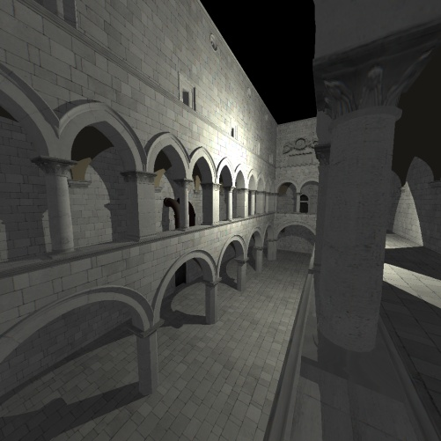
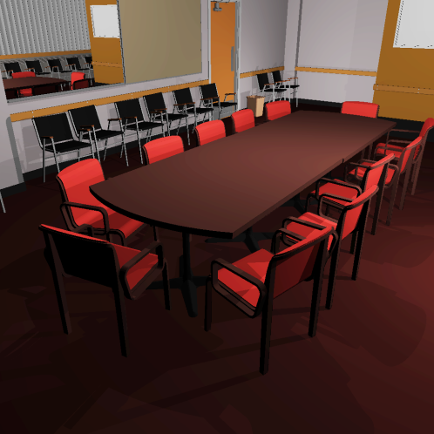
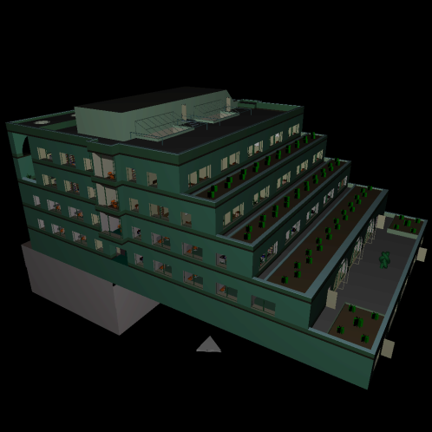
Performance
packet kd-tree | Sponza | Conference | Soda Hall
OpenRT | 4.5 | 4.2 | 5.1
Manta | 4.7 | 4.2 | 5.4
RTfact | 6.8 | 6.4 | 6.5
frustum BVH | Sponza | Conference | Soda Hall
DynBVH | N/A | 9.3 | 11.1
Manta | 4.5 | 4.8 | 5.6
Arauna | 13.2 | 11.3 | N/A
RTfact | 13.1 | 11.6 | 11.4

Slide 42
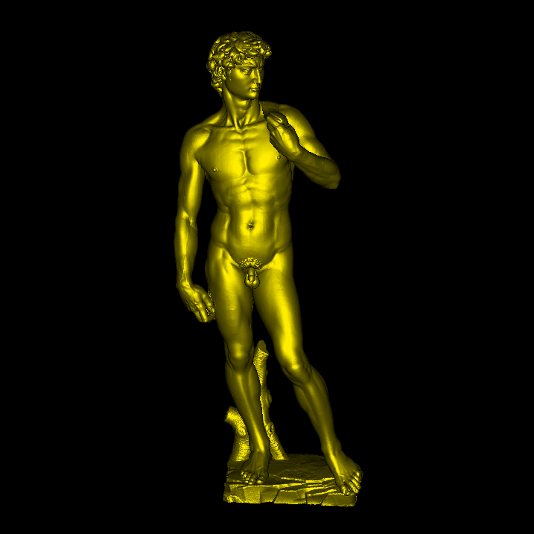
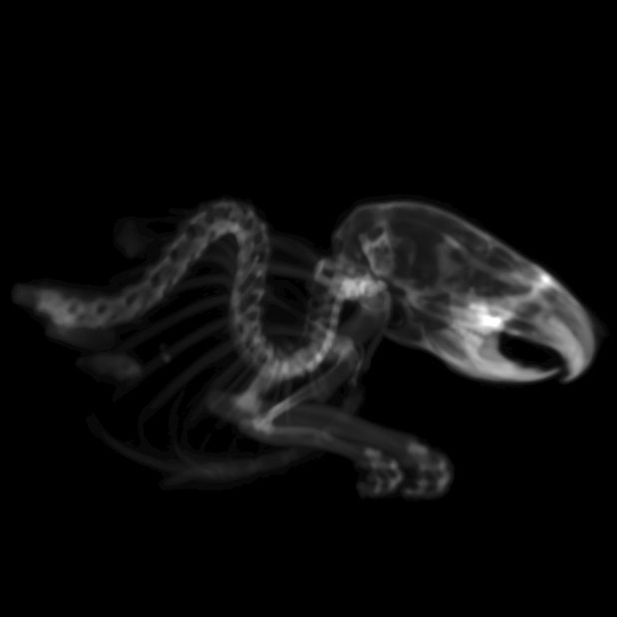
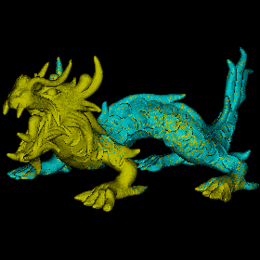
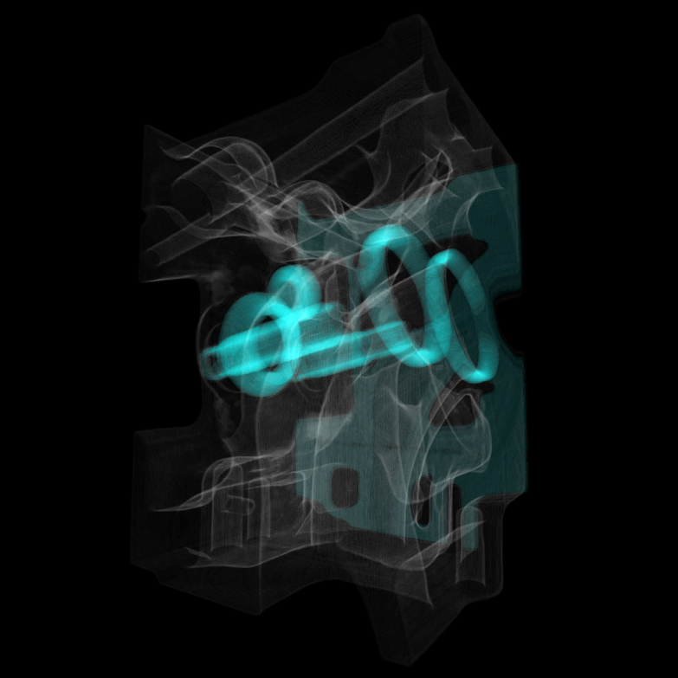
Applications
Mouse (CT scan)
Dragon (3.6M points)
David (3.7M points)
Engine (CT scan)

Slide 43
Conclusions and Future Work
RTfact
Generic ray tracing framework
Composability and extensibility
High performance
Not a perfect solution
Many language limitations
Future
Release as open source
Integrate into a scene graph library
To be used in DFKI visualization center
Explore other language approaches

Slide 44
Questions?

