Slide 1

Bidirectional Light Transport with Vertex Merging
SIGGRAPH Asia 2011
technical sketch

Slide 2

Bidirectional Light Transport
with Vertex Merging
Iliyan Georgiev Jaroslav Křivánek Philipp Slusallek

Slide 3
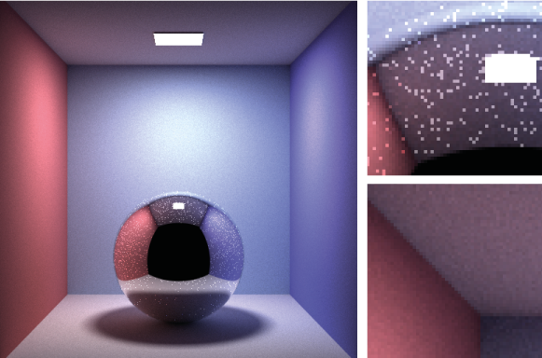
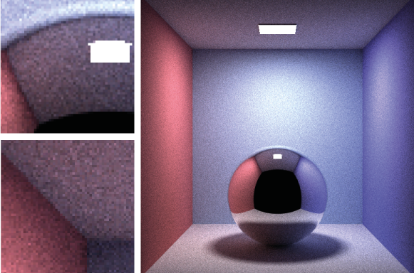
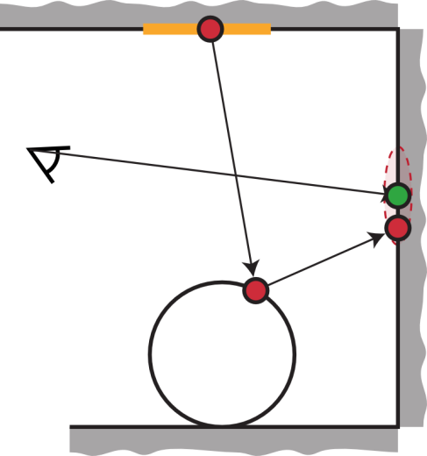

State of the art
Bidirectional path tracing
Progressive photon mapping
Caustics
Reflected caustics
Caustics
Reflected caustics

Slide 4
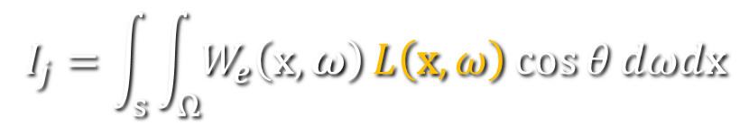
Light transport
Measurement equation
$$I_{j}=\int_{s}{\int_{Ω}{W_{e}\left(\text{x},ω\right)}L\left(\text{x},ω\right)\cos{θ}dωd\text{x}}$$
$$L\left(\text{x},ω_{o}\right)=L_{e}\left(\text{x},ω_{o}\right)+\int_{Ω}{f_{r}\left(ω_{i},\text{x},ω_{o}\right)}L\left(r(\text{x},ω_{i}),−ω_{i}\right)\cos{θ_{i}}dω_{i}$$

Slide 5

Light transport
Measurement equation
$$I_{j}=\int_{s}{\int_{Ω}{W_{e}\left(\text{x},ω\right)}L\left(\text{x},ω\right)\cos{θ}dωd\text{x}}$$
$$L\left(\text{x},ω_{o}\right)=L_{e}\left(\text{x},ω_{o}\right)+\int_{Ω}{f_{r}\left(ω_{i},\text{x},ω_{o}\right)}L\left(r(\text{x},ω_{i}),−ω_{i}\right)\cos{θ_{i}}dω_{i}$$
=
$$\frac{d^{2}Φ_{i}(\text{x},ω_{i})}{cos θ_{i}dω_{i}dA_{i}}$$

Slide 6
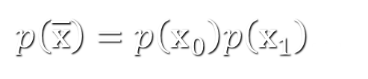


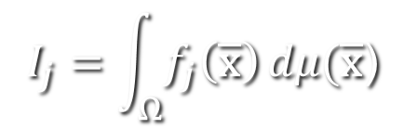
Light transport
Measurement equation
Path integral formulation
  Multiple importance sampling
$$I_{j}=\int_{s}{\int_{Ω}{W_{e}\left(\text{x},ω\right)}L\left(\text{x},ω\right)\cos{θ}dωd\text{x}}$$
$$L\left(\text{x},ω_{o}\right)=L_{e}\left(\text{x},ω_{o}\right)+\int_{Ω}{f_{r}\left(ω_{i},\text{x},ω_{o}\right)}L\left(r(\text{x},ω_{i}),−ω_{i}\right)\cos{θ_{i}}dω_{i}$$
=
$$\frac{d^{2}Φ_{i}(\text{x},ω_{i})}{cos θ_{i}dω_{i}dA_{i}}$$
$$I_{j}=\int_{Ω}{f_{j}\left(\overline{\text{x}}\right)}dμ(\overline{\text{x}}\text{)}$$
$$\overline{\text{x}}=\left({\text{x}}_{0},{\text{x}}_{1},…\right)$$
$$\left\langle I_{j}\right\rangle =\frac{f_{j}\left(\overline{\text{x}}\right)}{p\left(\overline{\text{x}}\right)}$$
$p\left(\overline{\text{x}}\right)=p\left({\text{x}}_{0}\right)p\left({\text{x}}_{1}\right)$…

Slide 7
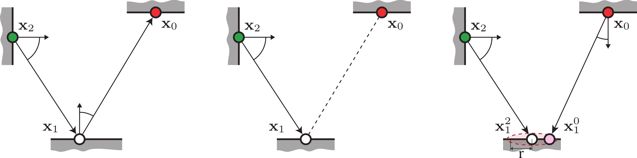
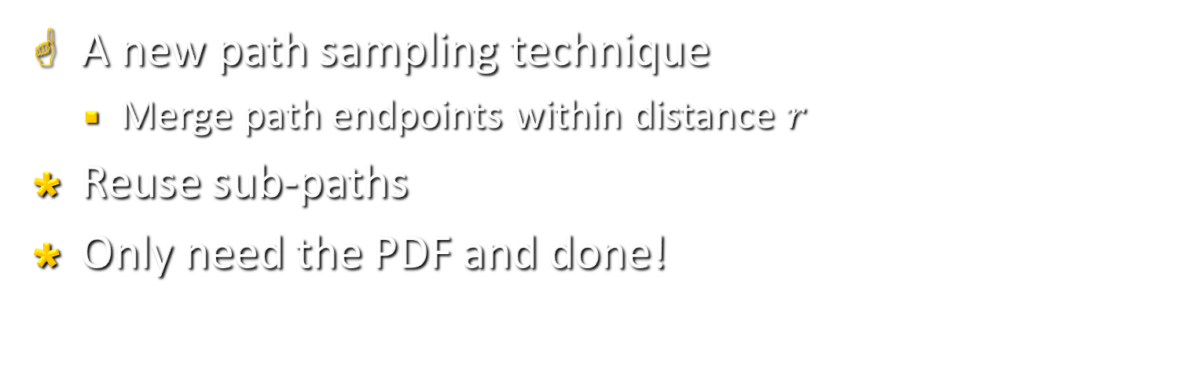
Vertex merging
A new path sampling technique
  Merge path endpoints within distance $r$
Reuse sub-paths
Only need the PDF and done!
Vertex merging

Slide 8

Vertex merging
A new path sampling technique
  Merge path endpoints within distance $r$
Reuse sub-paths
Only need the PDF and done!
Unidirectional sampling
Vertex connection
Vertex merging

Slide 9
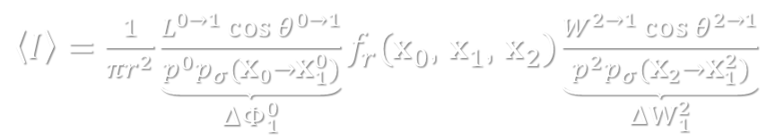
Vertex merging
PDF
Estimator
  Identical to photon mapping!
  No density estimation!
$$p\left({\text{x}}_{1}\right)≈p\left({\text{x}}_{2}^{}→{\text{x}}_{1}^{2}\right)p\left({\text{x}}_{0}^{}→{\text{x}}_{1}^{0}\right)πr^{2}$$
$\left\langle I\right\rangle =\frac{1}{πr^{2}}\underset{ΔΦ_{1}^{0}}{\underbrace{\frac{L^{0→1}\cos{θ^{0→1}}}{p^{0}p_{σ}({\text{x}}_{0}→{\text{x}}_{1}^{0})}}}f_{r}({\text{x}}_{0}$, ${\text{x}}_{1}$, ${\text{x}}_{2})\underset{ΔW_{1}^{2}}{\underbrace{\frac{W^{2→1}\cos{θ^{2→1}}}{p^{2}p_{σ}({\text{x}}_{2}→{\text{x}}_{1}^{2})}}}$
Vertex merging

Slide 10
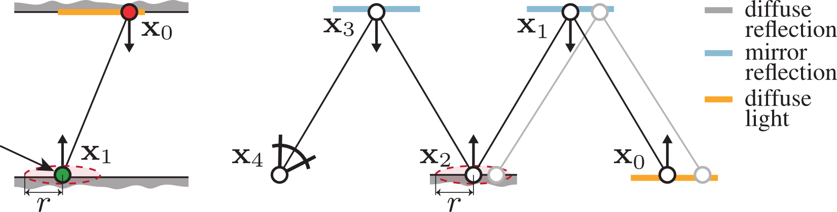
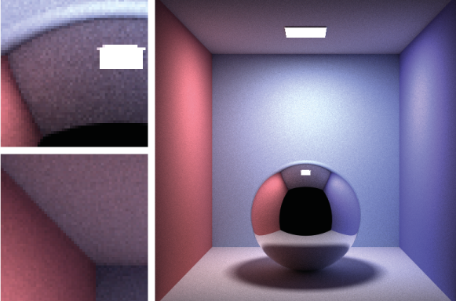


Technique comparison
Diffuse interactions
Observation
VC – orders of magnitude higher PDF
VM not robust for diffuse transport
$$p_{VM} ∝ p_{VC}⋅ \frac{r^{2}}{d^{2}}$$
$p_{VM} ∝$ $p_{US}⋅ \frac{A_{region}}{A_{light}}$

Slide 11


Technique comparison
Specular-diffuse-specular transport
Observation
VM – not more robust
Path reuse – key to efficiency!
  US – cannot
  VC – costly (e.g. instant radiosity)
  VM has lower variance for SDS paths
Combine with MIS
$$p_{VC}=0$$
$p_{VM} ∝$ $p_{US}⋅ \frac{A_{region}}{A_{light}}$

Slide 12
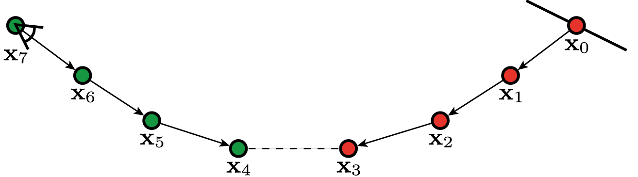
Example path
14 ways to generate the path!
  Unidirectional sampling – 1 way
  Vertex connection – 7 ways
  Vertex merging – 6 ways (new)

Slide 13
A combined algorithm
Trace all light paths
  Build kd-tree, grid, …
Path tracing – at each vertex:
  Connect to lights
  Connect to light vertices
  Merge with light vertices
  Combine all using MIS
Efficient MIS weight computation

Slide 14
Results
Bidirectional path tracing
Combined BDPT+VM
Progressive photon mapping
BDPT
Combined
PPM
BDPT
Combined
PPM

Slide 15
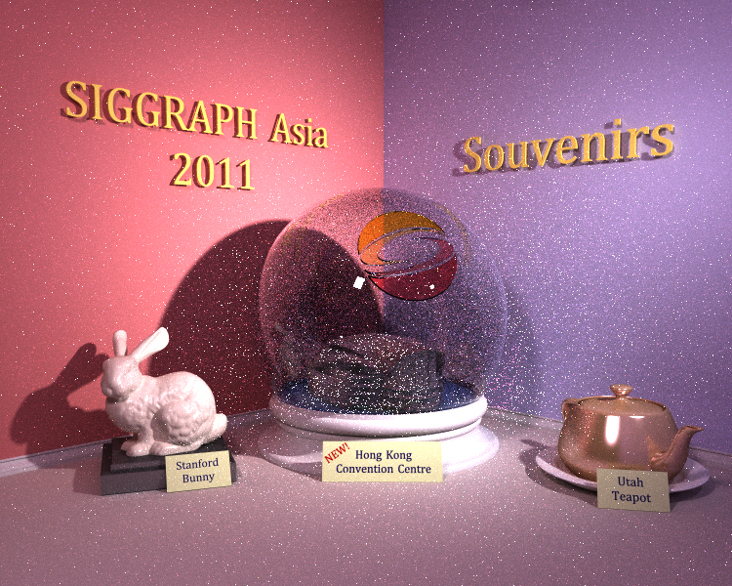
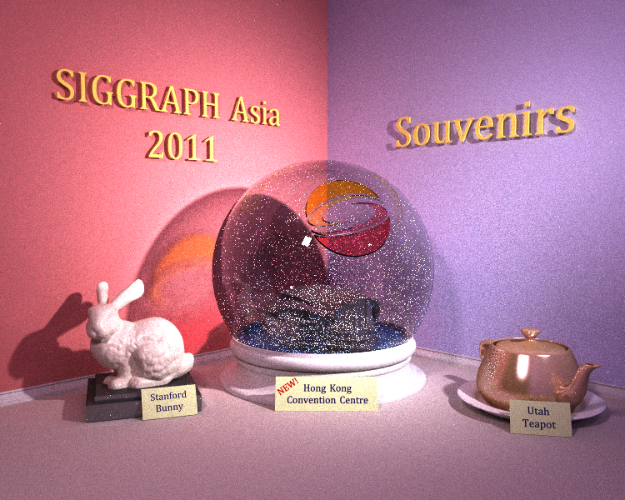
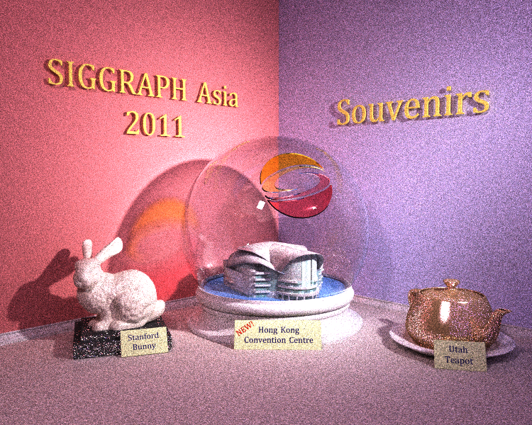

PT
BDPT
PPM
VM

Slide 16
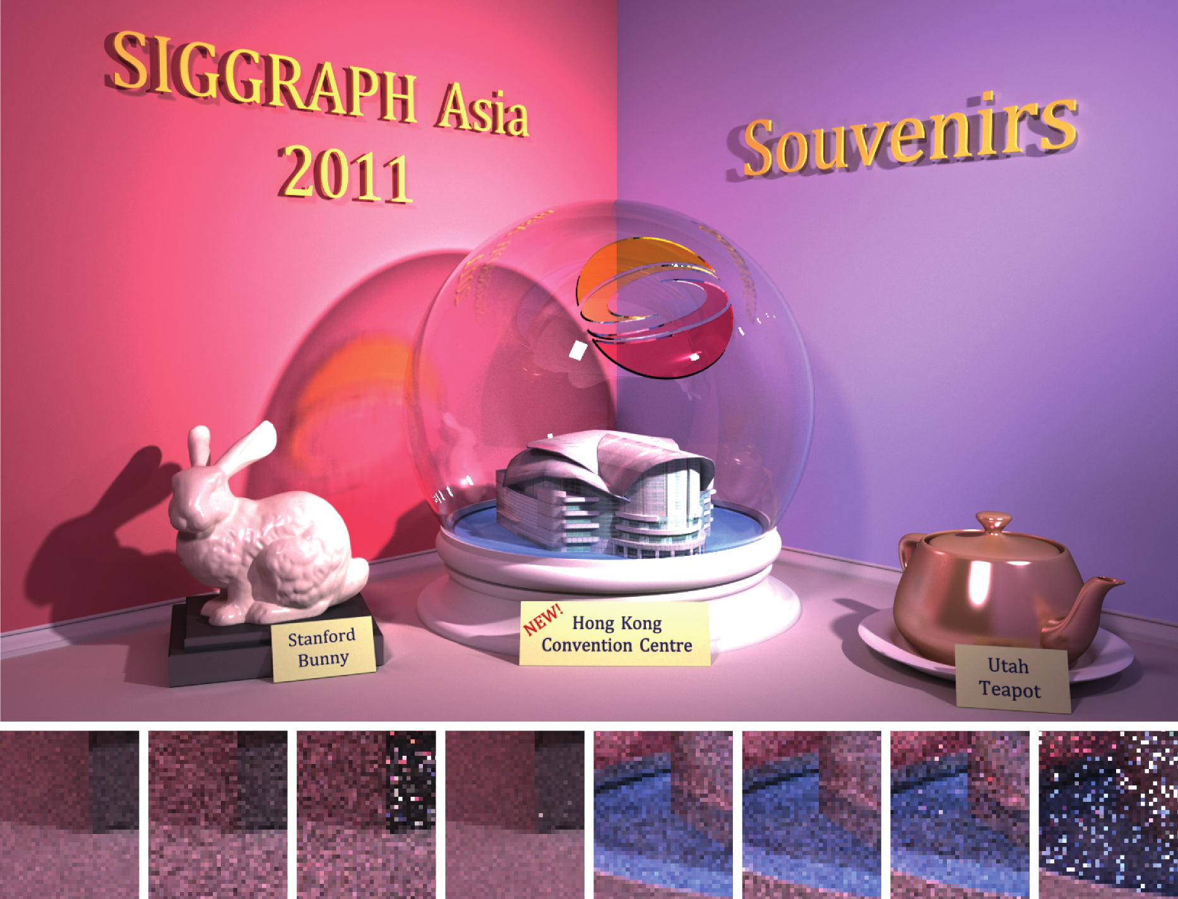
Results
Combined
VM
PPM
BDPT
Combined
VM
PPM
BDPT
Diffuse
Reflected caustics

Slide 17
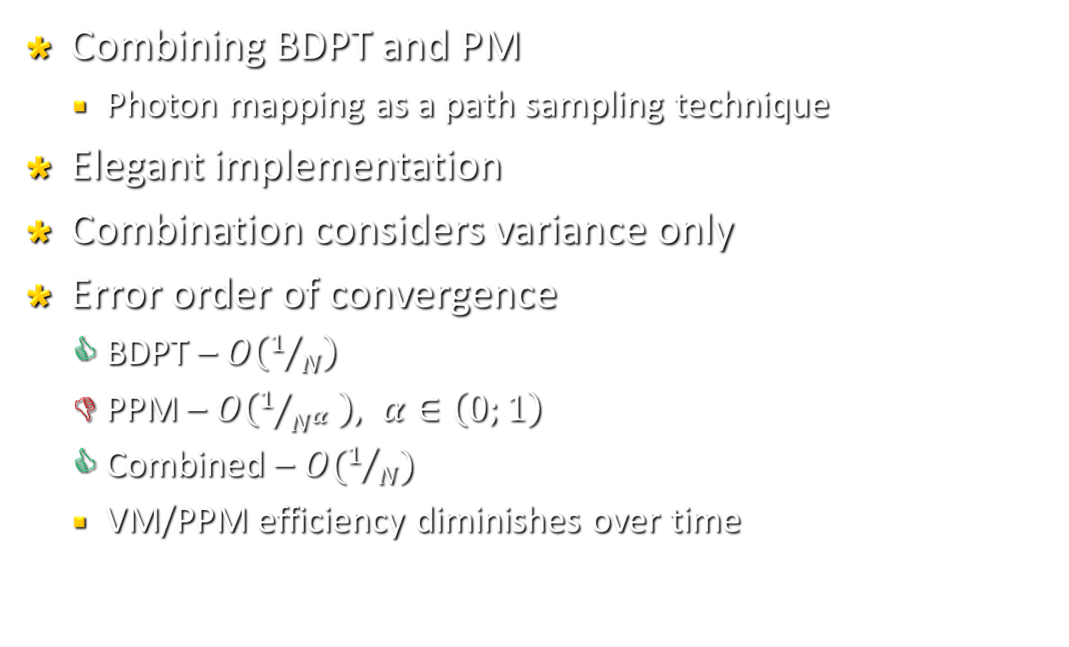
Summary
Combining BDPT and PM
  Photon mapping as a path sampling technique
Elegant implementation
Combination considers variance only
Error order of convergence
  BDPT – $O\left(1/N\right)$
  PPM – $O\left(1/{N^{α}} \right), α∈\left(0;1\right)$
  Combined – $O(1/N)$
  VM/PPM efficiency diminishes over time

